Slide 1

Customer Behavior Analysis
End-to-End Data Analytics Project — Python · SQL · Power BI

Slide 2

Project Overview
MySQL
SQL analysis & business insights
Power BI
Python
Interactive dashboard & visualization
Data cleaning & preprocessing
Transforming raw customer data into actionable business insights across 3,900 rows and 18 columns.

Slide 3

Data Cleaning in Python
01
Imported CSV
3,900 rows, 18 columns
02
Missing Values
37 gaps in Review Rating → filled with mean
03
New Columns
Age Group (Young Adult → Senior) & purchase_frequency_days
04
Exported
Saved as customer_behavior_cleaned

Slide 4
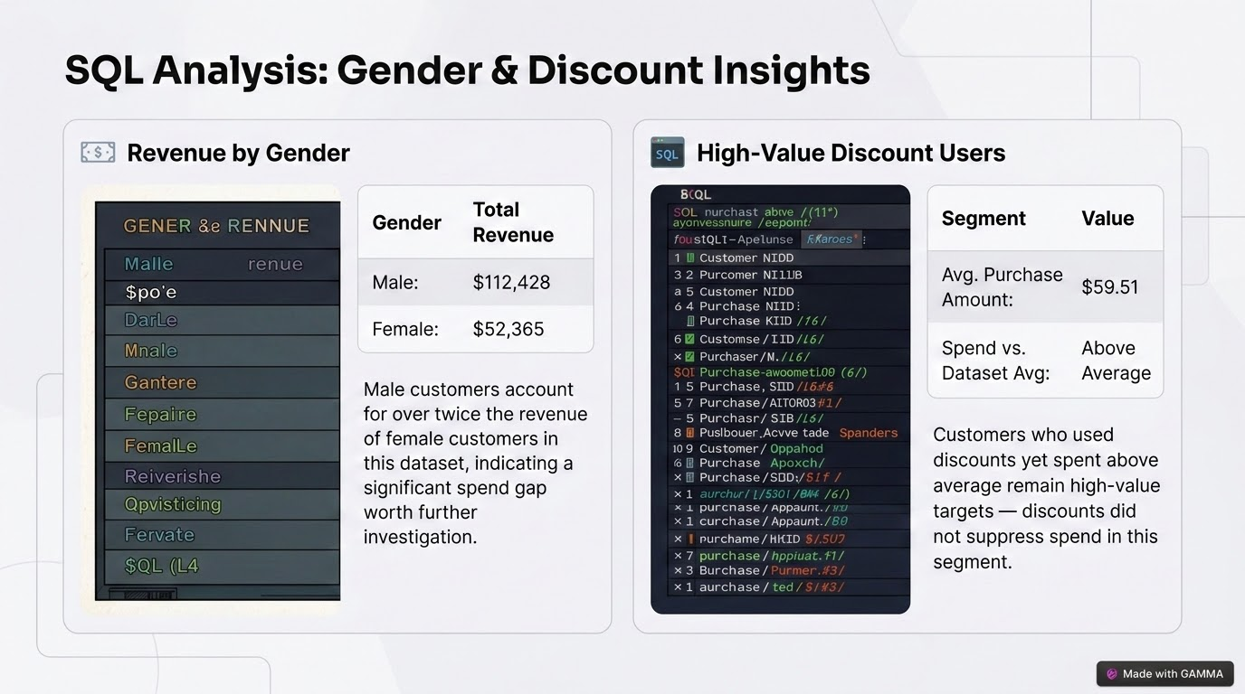

Slide 5

SQL Analysis: Product & Shipping Performance
Top 5 Products by Review Rating
Gloves — highest rated product
Sandals — strong customer satisfaction
Boots — consistent positive reviews
Jacket — well-regarded by buyers
Skirt — rounds out the top five
Shipping Type Cost Comparison
Express Shipping — avg. order value of $61.34
Standard Shipping — avg. order value of $58.21
Express orders trend ~$3.13 higher on average, suggesting customers purchasing premium items opt for faster delivery

Slide 6
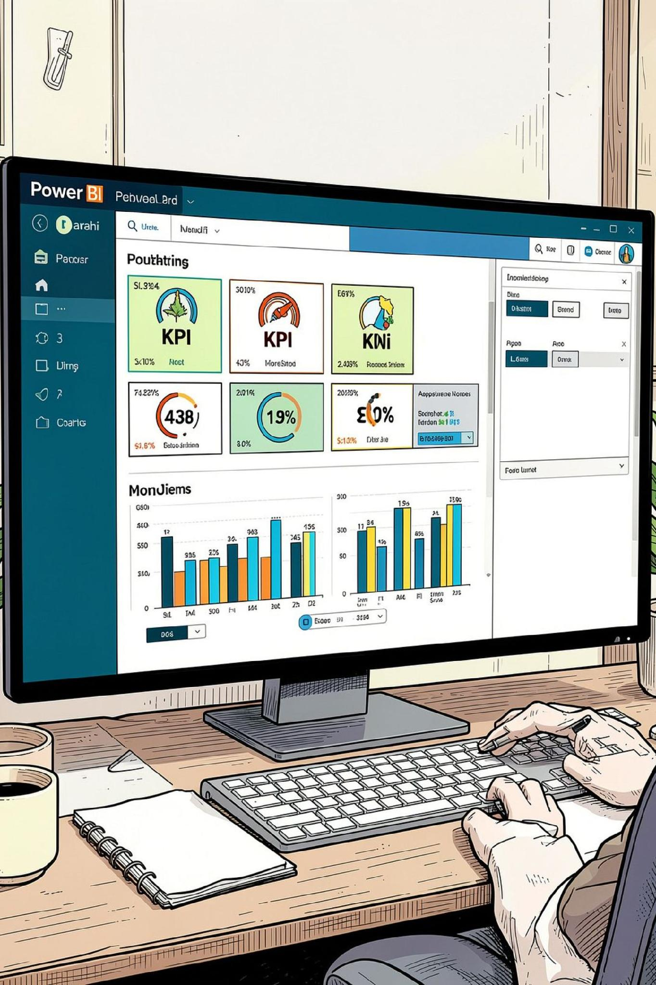
Power BI Dashboard
3K Customers
$59.51 Avg Purchase
3.75 Avg Rating
Interactive filters: Subscription Status, Gender, Category, Shipping Type

Slide 7
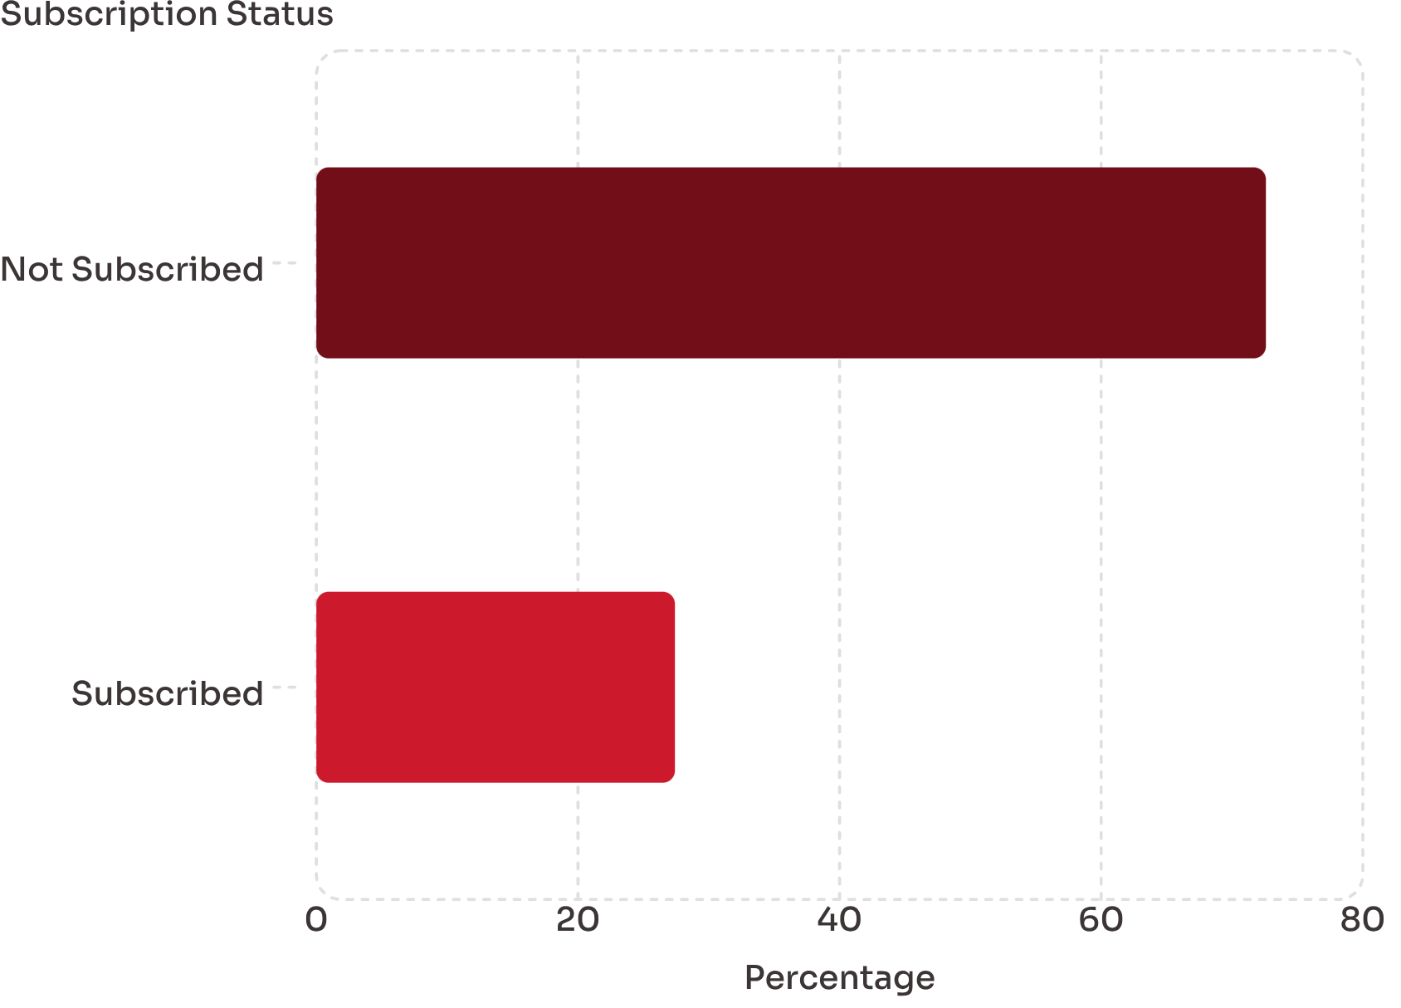
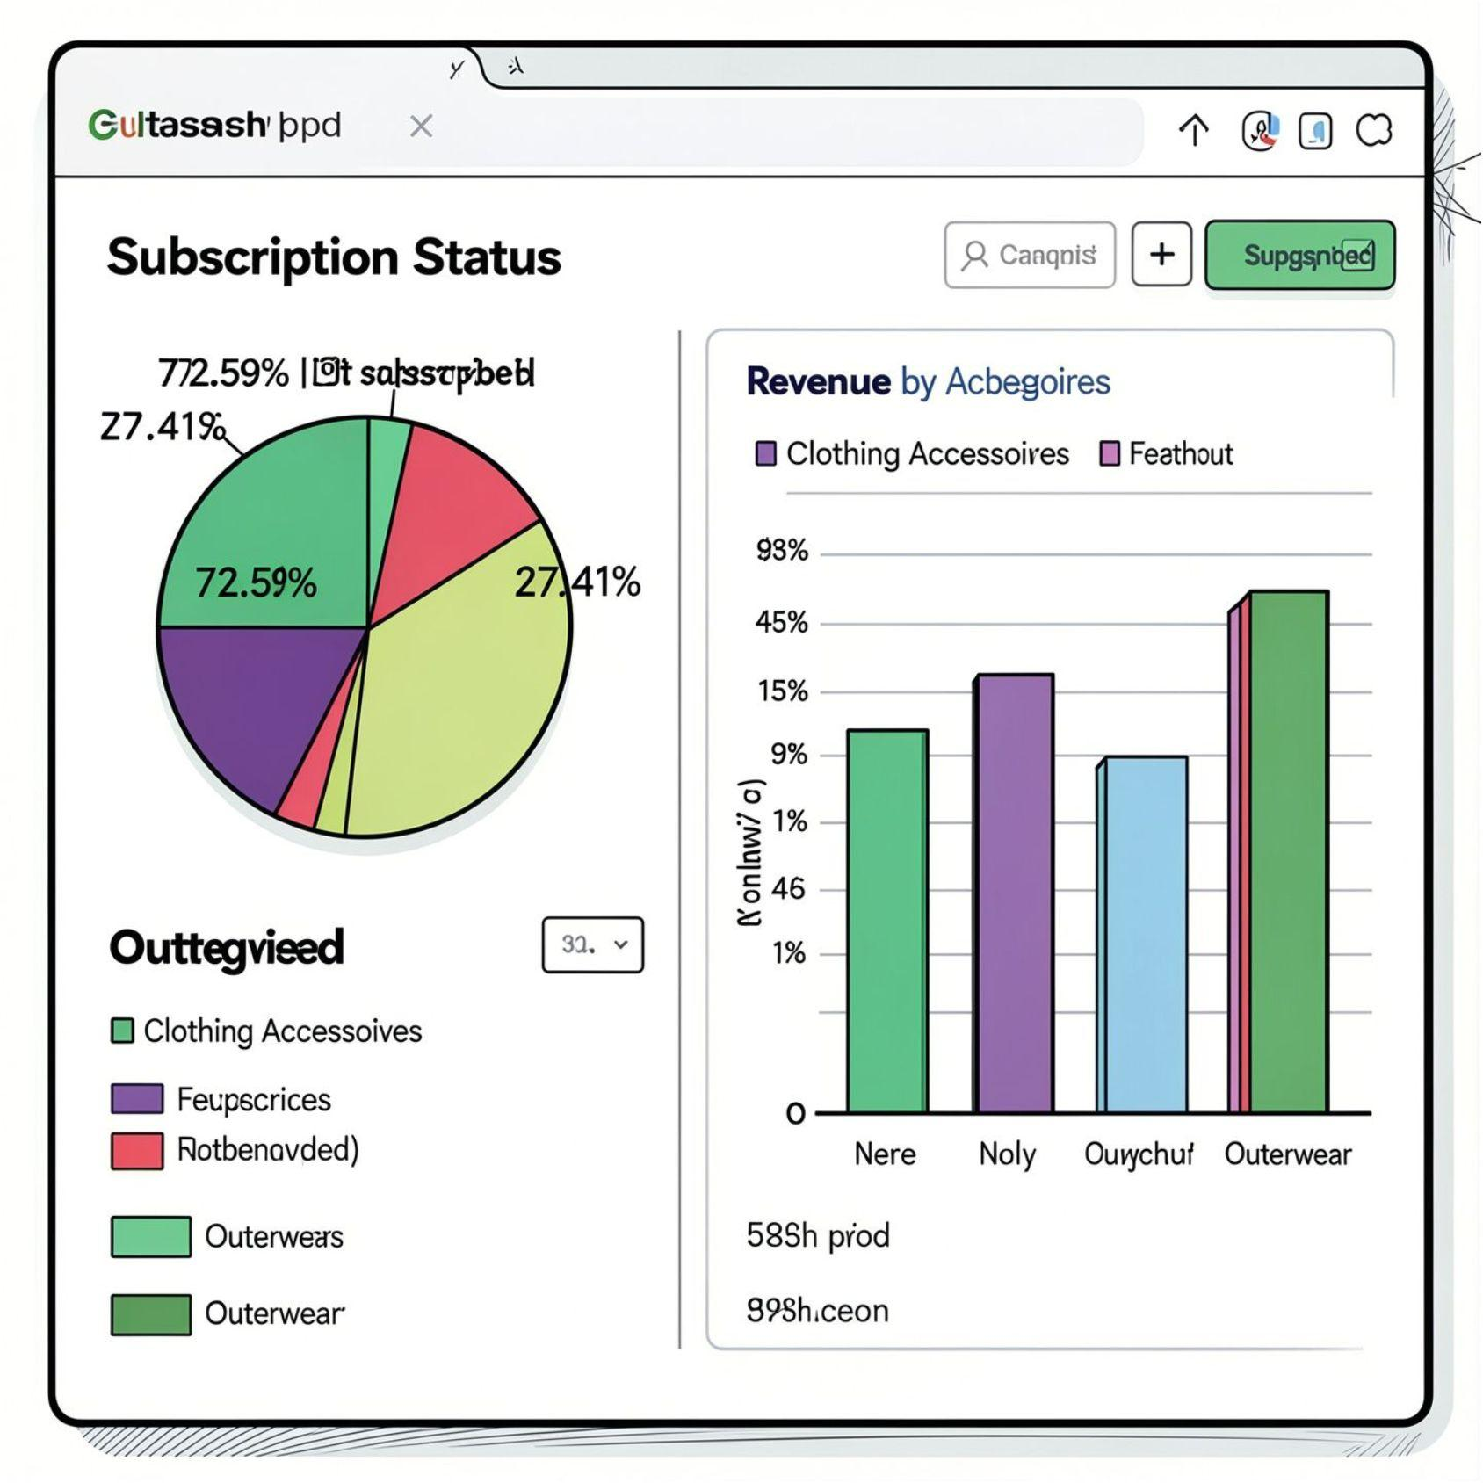
Key Insights: Subscription & Category
Subscription Gap
72.59% of customers are not subscribed — major growth opportunity.
Revenue by Category
Clothing leads in revenue, followed by Accessories.

Slide 8
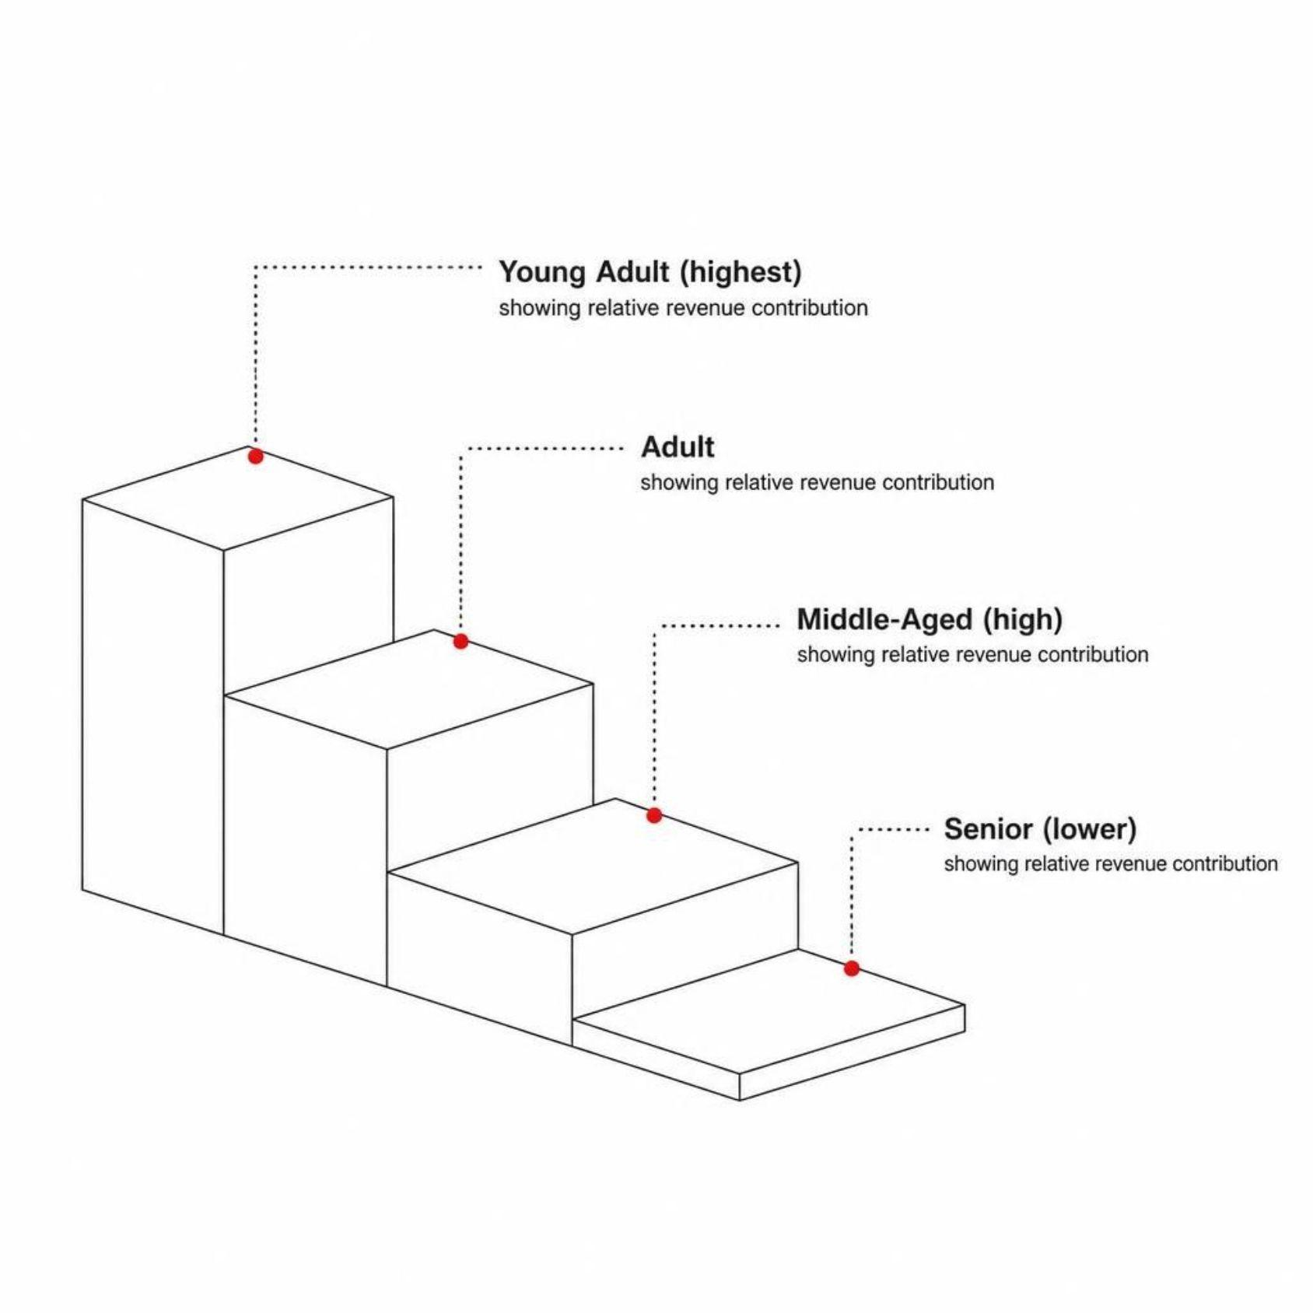
Key Insights: Age Group & Spending
Age Group Revenue
Young Adult and Middle-Aged customers drive the strongest revenue. Sales are relatively close across all age groups.

Slide 9
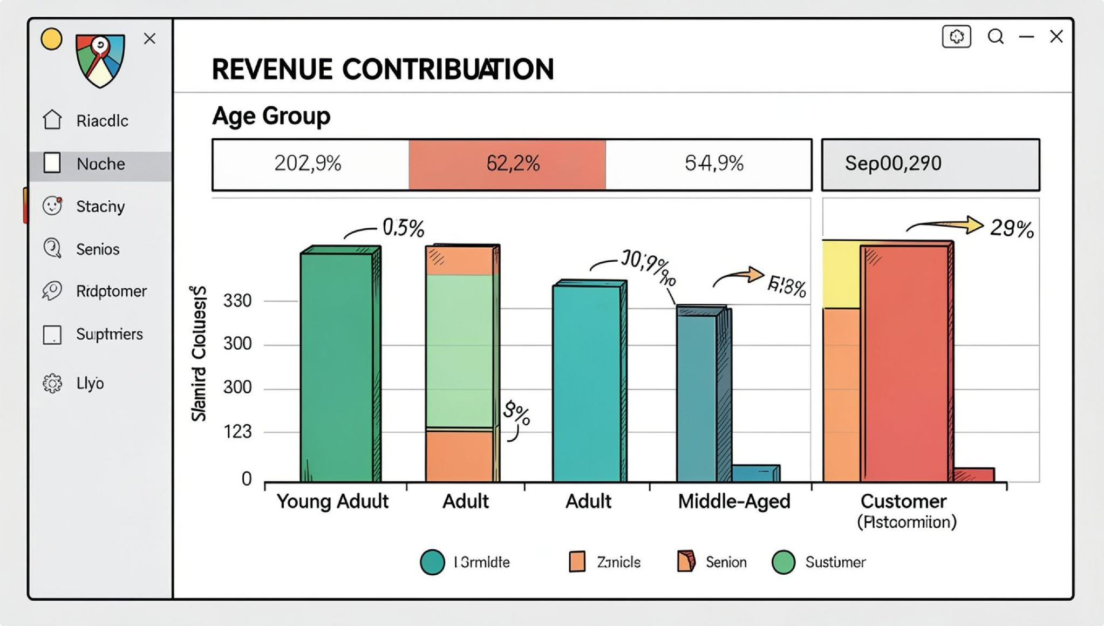

Slide 10


Business Recommendations
Target High-Revenue Categories
Focus on Clothing & Accessories
Boost Subscription Adoption
Campaigns for non-subscribed customers
Loyalty Promotions
Personalized offers for Returning & Loyal segments
Monitor Ratings & Discounts
Track feedback; ensure promos protect revenue

Slide 11

Conclusion
Python
MySQL
Power BI
Cleaned & preprocessed 3,900 rows
Answered 10 business questions
Interactive dashboard with actionable insights
Raw customer data → meaningful business insights. Skills strengthened: data cleaning, SQL querying, visualization & dashboard development.

